Slide 1

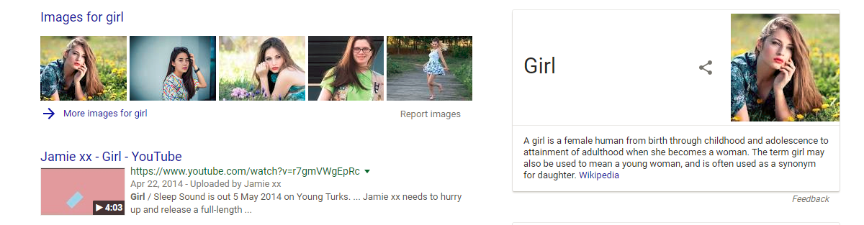
AI Product : Recommendation System
amazon
google

Slide 2
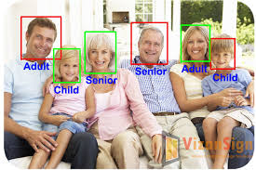
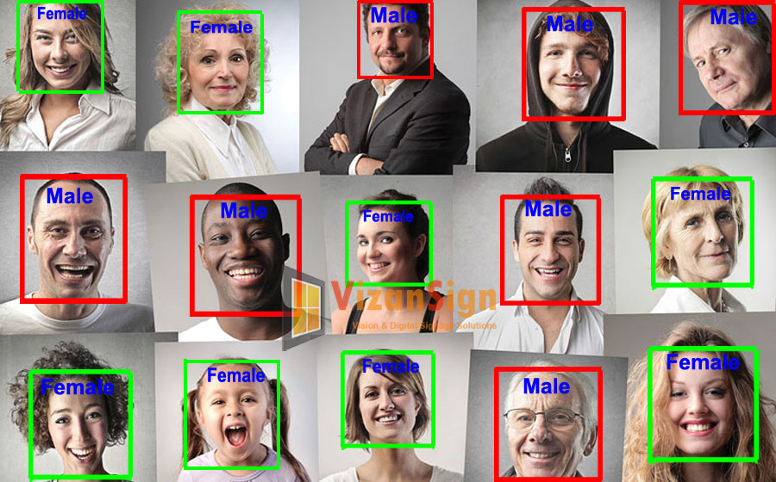
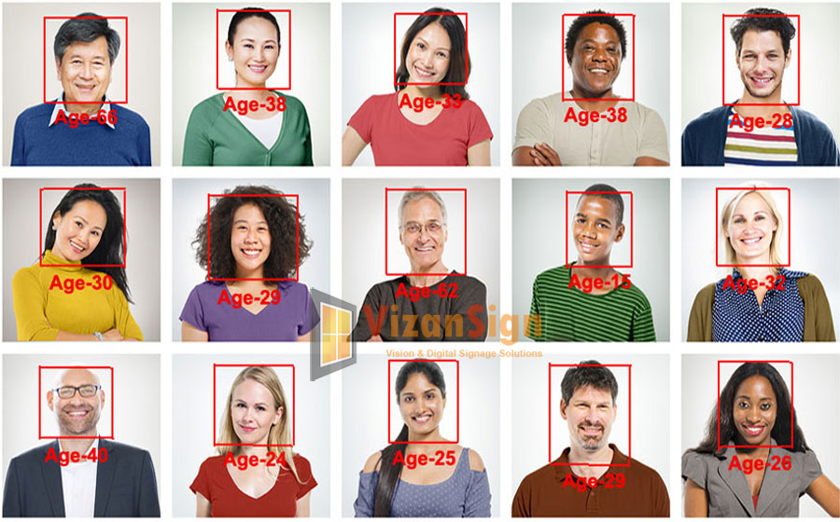
AI Product : Image Recognition

Slide 3

The usual quality assurance category
Flow Control
Gant diagram/ Dashboard
Agile / Continue integration
Testing Design
Equivalence class/boundary value/causal diagram
Abnormal / Fault Tolerant / Security
Testing Execute
Exploratory testing
Automation
More complete, more efficient, and lower cost
Poke ,look and
see if you are right
Testing Analysis
Root cause/convergence analysis
Performance bottleneck analysis
The extension of traditional testing methods:
Crowdsourcing, monitoring, user experience evaluation

Slide 4
AI Product Quality Assurance
Acceptance index Testing data Testing method Result Analysis
Near the scene
The equipment is placed according to the actual scenario, and the data of the result is obtained by orthogonal manual test input.
The results of multi-test methods tend to be consistent or reasonable.
Accuracy > 95%
online sampling data
human record data
software synthesis data
Mixture noise data, such as chatting etc environmental nosie
Note: prediction result match true labels after omitting insert, delete, replace errors
Voice recognition
Compared with the historical version, the results tend to be consistent or reasonable.
The test data distribution is consistent with the actual user distribution.
Fast the scene
By means of software synthesis and playback of audio, a larger volume of results data is obtained
5 meter，
Accuracy > 92%
Correction and interpretation of index calculation, result deviation of sample selection.
note：the comprehensive conclusion that simulating home sence from a distance near microphone

Slide 5
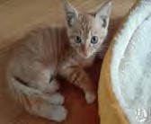

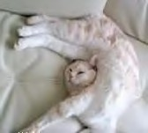

Basic Acceptance Index
TP: true positive
FP: false positive
FN: false negative
TN: true negative
Actual is Cat
（P）
Actual si not Cat（N）
TP FP
precesion = TP/(TP+FP)
the rate prediction is cat is true cat
Prediction is Cat
（T）
recall = TP/(TP+FN)
the rate the prediction is right in contain cat
F = 2RP/(R+P)
accuracy = (TP+TN)/(P+N)
，the overall rate the prediction is right
Prediction is not cat
（F）
Specificity = TN/(TN + FP) Missing Alarm = FN/(TP + FN) False Alarm = FP / (TP + FP)
FN TN
Cat detector：return TRUE when there is a cat.

Slide 6
Case study: Image Recognition
TP: true positive
FP: false positive
FN: false negative
TN: true negative
TP FP
Scene Indicator Value
Scene 1: search pornographic picture for removing
Actual porn
（P）
Actual norm
(N)
recall
96%
1000 pornographic images, mixed with normal samples
There were 1, 000 images(porn:980,norm:20), which 970 images were judged to be true pornographic , and 30 were judged to be norm. The recall is 96%. The precession is 98%.the accuracy =97%
Predicted
Porn
（T）
porn
960
10
970
precision
98%
Predicted norm
（F）
20
10
30
accuracy
0.97
FN TN
980
20
1,000
Scene 2: prohibit pornographic picture poster
recall
98%
Actual porn
（P）
Actual norm
(N)
1000 normal pictures, a number of mixed pornographic samples.
There were 1, 000 norm images, 980 were judged right, and 20 were wrong. the normal figures were 1167, 980 images were right and 187 images were wrong.
norm
precision
84%
Predicted
Porn
（T）
？
20
accuracy
0.83
Predicted norm
（F）
187
980
1167
1000

Slide 7
Testing data samples
Voice Recognition
Pronunciation characteristics: men and women, old and young, accent, tone and speed.
Language content: language, long sentence, Chinese and English mix, special name.
Noise environment: human voice, traffic, air conditioning, TV, music, communication equipment.
Application scenarios: on-board off-line, far-field identification, microphone array.
Face detection
Base: multi-face, face size.
Interference: occlusion, side face, hat, glasses.
Light source: dark light, reflective, overexposed, glass reflective.
Image: blur, defocus, black and white.
Subdivision: old man, foreigner, cartoon face.

Slide 8











Testing dataset according to the scenario
Single face
Licenses contrast
Multi-face
证照对比
Testing
data
Non-human face
X
Shield
Face gate
人脸机
Application Scenario
foreigner
Side face
侧脸
Security camera
high angle shot
Dark light

Slide 9
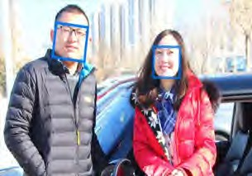

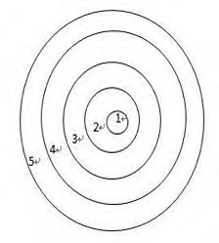

Testing Data acquisition
manually annotation
Case 1
Self annotation
Setup annotation team
Crowd sourcing
Data reuse
idea： Use "validation" instead of “annotation"”
Buy or use benchmark data
Online/offline data
Case 2
data synthesis
Generate noise data
Generate images with different exposures from the same face
idea： use "simulation" instead of "collection”

Slide 10
Fitting of testing data
Case 1:
Measurement method: distance device from 0 to 5 meters, fixed placement, each key point of different recording people to read the corpus repeatedly.
Simulation method: through the near field (0 meters) recording corpus, the data of different distances are calculated.
when the above conclusions tend to be consistent, it is considered that the simulated data has a higher fidelity and can be used for acceptance.
Simulation data fit with measured data.
The sample is expanded by means of simulation.
The measured data in the same scenario.
Compare the distribution of key indicators.
Revised data synthesis scheme.
Fit testing datasets
The intersection of multiple sets.
Compare the deviation of the intersection part to identify the relative confidence coefficient.
Revise some of testing sets.
case2
Sample 1: company ERP system export information.(gender/age)
Sample 2: the cooperative friends import the CRM data.
Sample 3: user registration information.
Sample 4: derive information based on user behavior annotation.
。
The sample sources used for evaluation are inconsistent and the confidence level is inconsistent. According to the relative relation between samples , do the sample confidence analysis.

Slide 11
Common errors selected testing data
Sample quantity
The quantity is too small, for example: take the single digit sample to determine the accuracy.
Data bias: there are only five pornographic images in a thousand pictures.
Sample distribution
Sample generalization, for example: in the navigation and intelligent speaker scene, the Chinese and English mixed identification.
Scene deviation, for example: the deployment of face recognition is separated by glass.
The number of positive and negative cases is not equal, e.g.
Evaluation set selection
Overfitting
Not using cross-validation

Slide 12
Result analysis
Vertical benchmarking
Horizontal
benchmarking
The same indicator and same data
Different model / parameters
v1
v2
v3
v4
v5
s1
s2
s3
s4
s5
Common problems： before and after the test report gives a very different conclusion, the data is discontinuous.

Slide 13
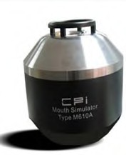
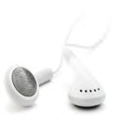
Testing process
Evaluate testing result
Testing enviroment
境
Low cost
high frequency
Evaluate
model
Collect
data
Testing execution
Testing sample
Adjust model parameters
Learning Loop

Slide 14


Testing system
样例 样例 样例 样例 样例 样例 样例 样例 样例 样例 样例
Test
Set
配 置 三 要 素
Testing data?
REPORT
step1：select sample
method?
Fitting sample
Test Set
standard?
process
Test Set
step3：compute indicator
Test Set
Data1：√ Data2：√ Data3：× Data4：√
step2：execute result
interface
execution model
model
model
model

Slide 15
Result analysis
Data
collection
Evaluate index
Horizontal/vertical alignment has a large fluctuation and does not meet the expected target.
Testing data
Correct become error,
Errors become correct
Analyze negative
feature
Evaluate
result
Adjust parameter
Negative
sample feature
Eg,Foreigner face is detect rate is low
Optimize negative sampling
data
Evaluate
Test model
Classify data
To establish an independent evaluation set for foreigners

Slide 16
A Comparison
Traditional product AI product
requirement analysis acceptance standard
Testing design evaluate testing data
Execute Testing evaluate testing method
Evaluate testing result Evaluate testing result
Key points： Scene understanding
Test design

Slide 17
7 Innovative AI Test Automation Tools for the Future: The Third Wave
Applitools
SauceLabs
Testim
Sealights
Test.AI
Mabl
ReTest

Slide 18
Tools | SauceLabs | Testim | Applitoools | Sealights | Test.AI | Mabl | ReTest
Vendor/URL
Focuses
Tool Features
Platform
Technology
Test Modeling
Test Data Generation
Test Automation
Quality Assessment

Slide 19
Knowledge Modeling for AI Software
Function Testing
System
Testing
Behavior
Testing
AI Feature
Testing
Graphic User
Interface Testing

Slide 20
Testing Requirements Analysis for AI Software
Identifying AI features
For each identified feature, identify its AI testing requirements
Knowledge-based modeling for AI testing
Object Relation
Object Identification
Position relation
Single object
multiple objects
Position relation
Object
Object Behavior
Object Context
2D Context
Single behavior
Different behaviors
Current behaviors
3D Context
Classification
Single type of objects
Different types of objects

Slide 21










Training Modeling and Data Generation for AI Software
Ad-hoc Data Training
Data Model-based Training
AI Model (s)
AI Model (s)
Trainer
Trainer
AI Software
AI Software
Data-model
Data
Generation
Tool
Ad-hoc
collected
training data
Crowd-
Sourced
Trainer
Crowd-
Sourced
Trainer
Data-model
based training data
Learning
Method(s)
Learning
Method(s)
Ad-hoc training data collection and preparation
Ad-hoc data quality criteria for training data
Trainer: personal-based or crowd-sourced training
Approach: manual ad-hoc training approach
Data model-based training data generation
Ad-hoc data quality standards/criteria
Model-based training data generation and simulation
Trainer: personal-based or crowd-sourced training
Approach: manual training approach
automatic training data simulation

Slide 22








Training Modeling and Data Generation for AI Software
Knowledge-Based Quality Training
Knowledge-Based AI Quality Training
AI Model (s)
AI Model (s)
Trainer
Trainer
Knowledge
model
Knowledge
model
AI Software
AI Software
Knowledge
-based
quality
training data
Knowledge
-based quality
training data
Crowd-
Sourced
Trainers
Crowd-
Sourced
Trainers
Learning
Method(s)
& Tools
Data QA
model
AI
Learning
Tools
Data QA
model
Knowledge-based training data generation
Quality-driven training data generation
Model-based training data generation and simulation
Trainer: personal-based or crowd-sourced training
Approach: manual/automatic training approach
Knowledge-based training data generation
Quality-driven training data generation
Model-based training data generation and simulation
Trainer: personal-based or crowd-sourced training
Approach: AI-based automatic training approach

Slide 23
AI Software Test Quality Assessment
Timeline
%
AI-Software
Accuracy
%
Correctness
%
F1
Fk
Fn
Ai feature set (AiF)
F-s1
F-si
F-sm
Ai sub-feature set
Consistency
%
Completeness
%
QF
F-si
(TC)
Quality factor set (QF)
Test Complexity(TC)
Qf1
Qfj
TC(T1)
TC(Tm)
Quality
factor set (QF)
T1
Tm

Slide 24
AI Software Test Modeling
AI-Software
F1
Fk
Fn
AI knowledge test model
AI feature test model
Object test model
Data test model
Ai feature set (AiF)
F-s1
F-si
F-sm
Ai sub-feature set
T1
Tm
Test sets

Slide 25
AI Software Test Modeling
Identifying Object Class
Object Under
Different
Contexts
Different
Object
Attributes
Identifying
Sub-class
Identifying
Incorrect
Objects
Identifying
no objects
Object In Different Backgrounds
Object
Class #1
Attribute
Class #1
Object
Class #k
Attribute
Class #k
Object In
Different
Lighting
Object
Class #i
Attribute
Class #i
Object In
Different
Weather

Slide 26
AI Software Test Adequacy and Coverage
AI-Software
AI knowledge model test coverage
AI feature test coverage
Ai sub-feature test coverage
AI feature classification test coverage
Object-model test coverage
Object classification test coverage
Object context test coverage
Object relation test coverage
Data-model test coverage
Data classification test coverage
Data relation test coverage
Data format test coverage
Data range test coverage
F1
Fk
Fn
Ai feature set (AiF)
F-s1
F-si
F-sm
Ai sub-feature set
F-si
(TC)
Test Complexity(TC)
Qf1
Qfj
TC(T1)
TC(Tm)
Quality
factor set (QF)
T1
Tm

Slide 27
Tools | SauceLabs | Testim | Applitoools | Sealights | Test.AI | Mabl | ReTest
Vendor/URL
Focuses
Tool Features
Platform
Technology
Test Modeling
Test Data Generation
Test Automation
Quality Assessment

